Slide 1

LPAC Middle of the Year Training WS# 66134
Karina E. Chapa, M.Ed.
Language Proficiency, Biliteracy and Cultural Diversity Director
kchapa@esc1.net

Slide 2

Professional Learning Essential Agreements
Be respectful of others
Be an active participant
Take care of your needs
Use electronic devices as learning tools

Slide 3
Final LPAC MOY Power Point
The final PowerPoint and all other LPAC guides and documents will be posted on the Language Proficiency Assessment Committee Resources page of the Student Assessment Division website at:
http://tea.texas.gov/student.assessment/ell/lpac/

Slide 4
STAAR

Slide 5
STAAR Assessments
STAAR
STAAR
Spanish
STAAR
Alternate 2
Paper or online
Paper
Online

Slide 6
Changes for 2018 and Beyond
New
The guidelines described in this training are applicable for all assessments administered in the remainder of the 2017-2018 school year (spring and June 2018).
Beginning with the next school year, language proficiency assessment committees (LPACs) decisions will be applicable for all assessments administered in the 2018-2019 school year (December 2018, spring 2019 and June 2019).
    For December 2018 EOC administrations, LPAC participation and designated supports decision-making must take place during the fall of 2018, as close as possible to the assessment window.
DRAFT

Slide 7
STAAR Decision-Making Guide for LPACs
The regulatory procedural guide is based on 19 TAC Chapter 101, Subchapter AA.
  LPACs should be familiar with these Commissioner of Education rules.
TEA is required to develop administrative procedures to implement English language learners (ELLs) assessment statutory requirements.
LPACs are responsible for —
  following administrative procedures in the guide
  making decisions on an individual student basis
  working as a committee to make decisions
  maintaining required documentation
DRAFT

Slide 8
Participation Decisions

Slide 9
STAAR Participation Decisions
STAAR encompasses―
  STAAR
  STAAR Spanish
  STAAR Alternate 2
LPACs are required to make and document assessment decisions in accordance with outlined procedures.
DRAFT

Slide 10
Understanding Alignment of
STAAR and STAAR Spanish
Same:
Assessed curriculum and item types
STAAR blueprints for building tests
Achievement standard alignment
Focus on readiness for next grade level or course with
goal of postsecondary readiness
Differences:
Language accessibility
  STAAR Spanish—native language helps students understand language of test
DRAFT

Slide 11
STAAR Spanish Decisions
When making STAAR Spanish decisions, LPACs must
  make individual student decisions
  use input from student’s teacher(s), and
  determine STAAR Spanish to be most appropriate measure of student’s academic progress.
Grade-based or program-based decisions are not authorized.
LPACs recommend certain accommodations for students taking STAAR Spanish (please refer to the accommodations policies documents found on the Accommodation Resources webpage).
DRAFT

Slide 12
STAAR Spanish for Students in ESL Programs
In addition to being appropriate for ELLs in bilingual programs who are receiving academic instruction in Spanish, STAAR Spanish may sometimes be appropriate for students in ESL programs.
ESL program examples:
  Spanish speakers who have recently moved to the U.S.
  ELLs who have recently moved from a campus where they were enrolled in a bilingual program
  Students who receive substantial academic support in Spanish
DRAFT

Slide 13
Non-ELLs in Spanish Bilingual Programs
Non-ELLs in a state-approved bilingual education program may be administered STAAR Spanish if the LPAC determines the assessment in Spanish to be the most appropriate measure of the student’s academic progress.
  Chapter 101 requires the LPAC to make the decision when a request of this type is made for a non-ELL.
This is most common in two-way dual language programs but is not necessarily limited to these programs.
The LPAC is not responsible for performing the many other LPAC functions they carry out for ELLs.
DRAFT

Slide 14
Assessment Decisions for Different Subjects
Decisions will often vary by necessity because of the design of the STAAR program.
  For example, it may sometimes be appropriate to give STAAR Spanish in some subjects and STAAR in English in other subjects.
LPAC decisions to give a student one type of assessment for one subject and another type of assessment for another subject should be well-justified in the required documentation.
DRAFT

Slide 15
Assessment Decisions for ELLs Receiving Special Education Services
ELLs receiving special education services may be administered any assessment depending on whether they meet the participation requirements.
  STAAR
  STAAR Spanish
  STAAR Alternate 2
Chapter 101 of the TAC requires the LPAC to work in conjunction with the ARD committee to make assessment decisions for these students.
  This collaboration helps ensure that factors related to a student’s disability and second language acquisition are both carefully considered.
DRAFT

Slide 16
Designated Supports Decisions

Slide 17
Designated Supports Decisions for STAAR
LPAC’s designated supports decisions must be made on an individual student basis.
Decisions must be based on —
  student’s particular needs for second language acquisition support, and
  whether student routinely, independently and effectively uses the designated support in instruction and classroom testing.
LPACs must coordinate with subject-area teachers.
  Providing unfamiliar accommodations may hinder rather than help a student.
Designated supports decisions should be made as close as possible to the assessment to account for student’s progress in acquiring the English language.
DRAFT

Slide 18
Accessibility Resources
Designated Support decisions for STAAR are to be made by LPACs in accordance with policies and procedures in the following:
  2018 STAAR Decision-Making Guide for LPACs
  https://tea.texas.gov/student.assessment/ell/lpac/
  Accessibility Policy Documents located on TEA’s Accommodation Resources webpage
  https://tea.texas.gov/Student_Testing_and_Accountability/Testing/Student_Assessment_Overview/Accommodation_Resources/2018_Accessibility/
DRAFT

Slide 19
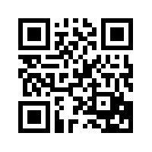
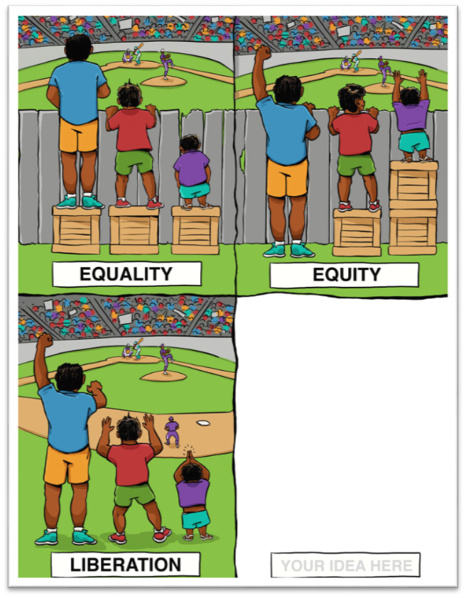
Think, Talk & Share
https://tinyurl.com/lpacmoy

Slide 20
Designated Supports During State Assessments
Designated Supports in instruction allow each student to maximize his or her academic potential.
Not all Designated Supports suitable for instruction are allowable during state assessments.
Using designated supports during an assessment allows test takers to demonstrate their knowledge of the content being tested without the format of the assessment, the non-tested language, or the type of responses needed to answer the questions being barriers.
DRAFT

Slide 21
Designated Supports for ELLs with Disabilities
LPACs are responsible for making designated support decisions for the STAAR program in conjunction with the student’s ARD, Section 504, RTI or other applicable committee.
  Designated supports decisions related to the student’s particular needs for second language acquisition support, and
  Designated supports decisions related to the student’s disability
These committees should become familiar with all information on the TEA Accommodation Resources webpage.
DRAFT

Slide 22
LPAC Role and Collaboration with Testing Coordinators
The LPAC’s role should not be to simply make decisions and process paperwork, but to also
  provide opportunities for guiding teachers,
  support the English language proficiency standards (ELPS) implementation, and
  determine needs for professional development.
Testing coordinators and LPACs must coordinate so that participation and designated supports decisions are available in time to make testing arrangements.
DRAFT

Slide 23
Understanding STAAR Accessibility

Slide 24
STAAR ACCESSIBILITY
Accessibility policy information can be found on the Accommodation Resources webpage.
Accessibility policies are divided into 3 categories
  Accessibility Features: Available to all students who need them
  Designated Supports: The appropriate team of people at the campus level has determined and documented that the student meets the revised eligibility criteria.
  Designated Supports Requiring TEA Approval: The appropriate team of people at the campus level has determined student eligibility and submitted an Accommodation Request Form to TEA.
DRAFT

Slide 25
Assessment Accommodations
3. Designated Supports (w/TEA approval)
2. Designated Supports (w/local approval)
1. Accessibility Features (all students)

Slide 26
Assessment Accommodations
3. Designated Supports (w/TEA approval)
2. Designated Supports (w/local approval)
1. Accessibility Features (all students)

Slide 27
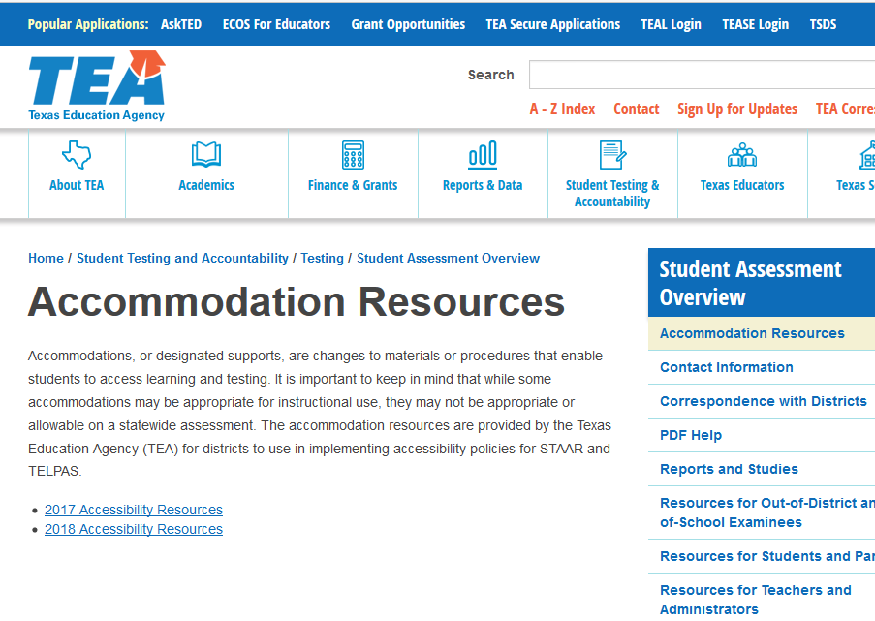
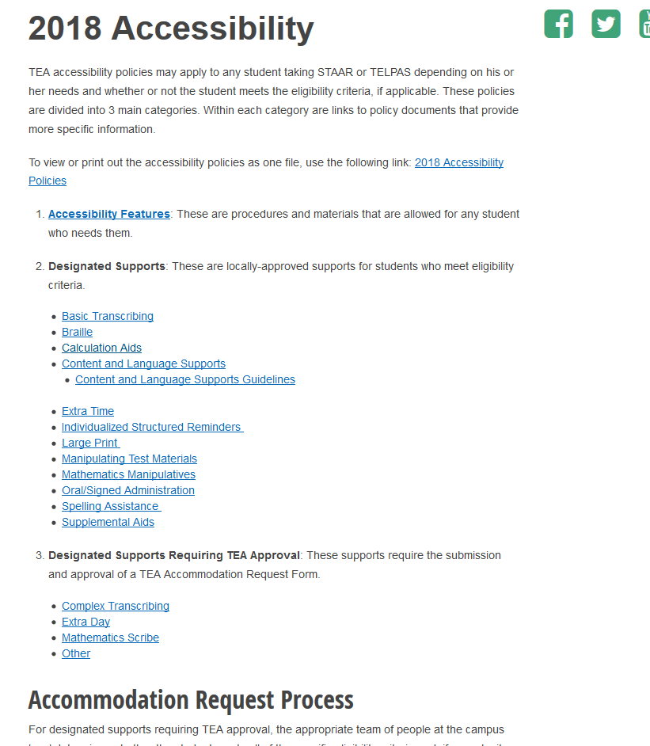
Accommodation Resources
New for Spring 2018

Slide 28
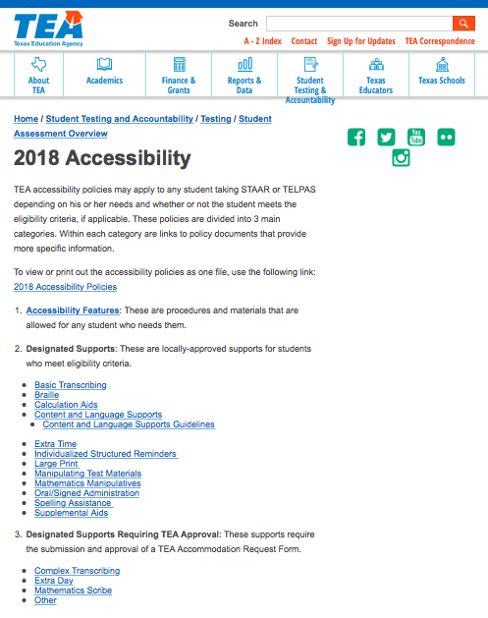
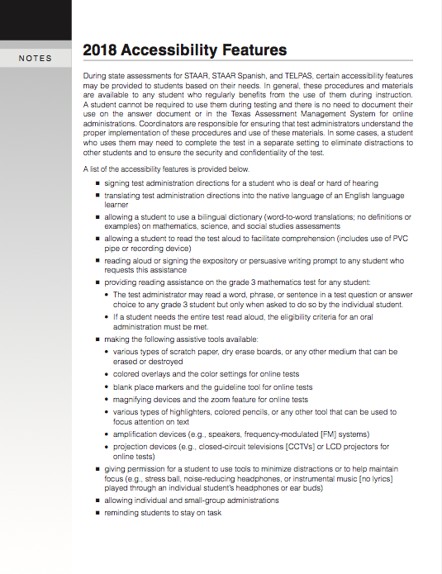
1. Accessibility Features

Slide 29

1. Accessibility Features
#1
#2
…and mingle!
#3
+Back

Slide 30
New Accessibility Features!
Use of amplification devices (e.g., speakers, frequency-modulated [FM] systems)
Use of projection devices (e.g., closed-circuit televisions [CCTVs] or LCD projectors for online tests)
DRAFT

Slide 31
Assessment Accommodations
3. Designated Supports (w/TEA approval)
2. Designated Supports (w/local approval)
1. Accessibility Features (all students)

Slide 32
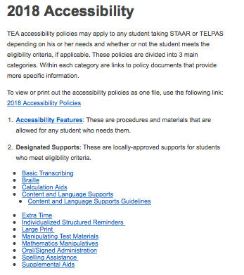
2. Designated Supports
STAAR, STAAR Spanish, and TELPAS accommodations:
  Description of Accommodation
  Assessments
  Student Eligibility Criteria
  Authority for Decision and Required Documentation
  Examples/Types
  Special Instructions/Considerations

Slide 33
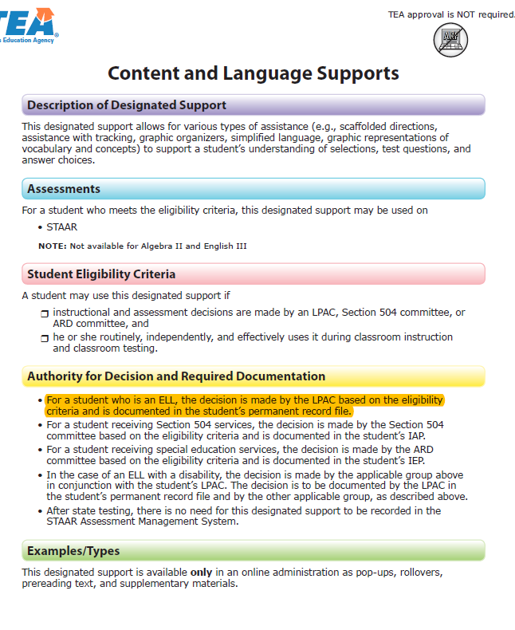
LPAC Decision-Making Authority
  The “Authority for Decision and Required Documentation” section of the document indicates the committee authorized to recommend the designated support.
  This bullet indicates that LPACs alone can recommend the use of the designated support.
DRAFT

Slide 34
*LPAC as Independent Authority
Basic Transcribing* | Braille | Calculation Aids | Content & Language Supports*^
Extra Time*^ | Individualized Structured Reminders* | Large Print* | Manipulating Test Materials*
Mathematics Manipulatives* | Oral/Signed Administration*^ | Spelling Assistance | Supplemental Aids*
OA, content and language supports are embedded in the STAAR online interface.
^ Linguistic Accommodations

Slide 35
Changes to Locally-Approved Designated Supports
New
  Content and language supports have been combined into one embedded support
  STAAR Calculator Policy now includes the use of calculators for grade 8 science
  Authority for decision for math manipulatives and supplemental aids has been expanded to include additional campus level teams (e.g., RTIs)
  Photocopy not a separate designated support but has been included within other policy documents (Large Print, Other).
DRAFT

Slide 36
2. Designated Supports
Extra Time*
Content and Language Supports*
Oral/Signed Administration*
Basic Transcribing
Braille^
Calculation Aides^
Large Print
Manipulating Test Materials
Mathematics Manipulatives
Individualized Structured Reminders
Spelling Assistance^
Supplemental Aids
Some of these designated supports are not new to the assessment program, but are NEW FOR LPACs.
^Sometimes these decisions are done in conjunction with other committees.
*Linguistic Accommodations: If given for R/W, student may not exit LEP status
Notes:
Teams of 3.. Name the team… Create a Frayer Model with name of the team in the back
Assign a Designated Support to each person on each team
Group by Designated Support (DS)
Each DS Group will develop a visual and a gesture to explain their DS… Visual at center of Frayer Model
Come back to Teams w names
Each DS explains their visual and gesture and rest of the team fills out one section of their Frayer Model
After each DS is explained, go on with those slides… Then next DS explains, team writes on model and slides cover that section… and so on until all 3 DS are covered.

Slide 37
2. Designated Supports
Extra Time*
Content and Language Supports*
Oral/Signed Administration*
INSTRUCTIONS
Read assigned text
Create a visual on your Frayer Model
Add 3 bullets with info (no more than 5 words each bullet)
*If given for R/W, student may not exit LEP status
Notes:
Teams of 3.. Name the team… Create a Frayer Model with name of the team in the back
Assign a Designated Support to each person on each team
Group by Designated Support (DS)
Each DS Group will develop a visual and a gesture to explain their DS… Visual at center of Frayer Model
Come back to Teams w names
Each DS explains their visual and gesture and rest of the team fills out one section of their Frayer Model
After each DS is explained, go on with those slides… Then next DS explains, team writes on model and slides cover that section… and so on until all 3 DS are covered.

Slide 38
Extra Time

Slide 39
Extra Time
Routine use in specified contexts: ELL must need and routinely be provided extra time when completing assignments and assessments that require substantial comprehension or use a substantial amount of English.
Second language acquisition needs: An ELL’s need for extra time must be based on second language acquisition factors related to the time the ELL needs to read meaningfully in English or write a meaningful response, as applicable.
Non-factors: Factors that are not ELL-specific must not be considered, such as test anxiety, use of test strategies, or other reasons not related to second language acquisition.
NOT an automatic decision!

Slide 40
Content & Language Supports

Slide 41
Content & Language Supports
Updated
Assessments and Student Eligibility Criteria
  These supports, mainly in the form of pre-reads, pop-ups, and rollovers, are available on STAAR online tests only.
  NOT available for Algebra II or English III.
  A student may use this support if he or she routinely, independently, and effectively uses this support during classroom instruction and testing.
DRAFT

Slide 42
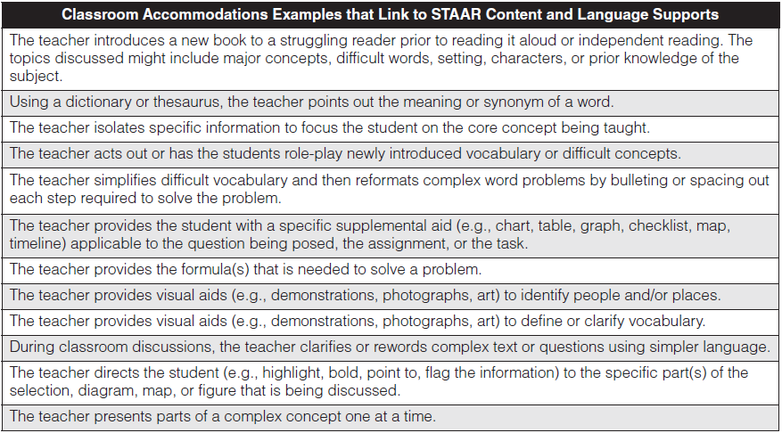
https://apps.esc1.net/ProfessionalDevelopment/RegionOne
WS# 65805
DRAFT

Slide 43
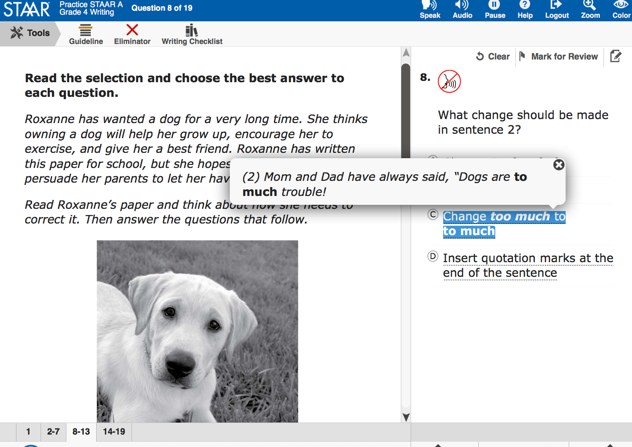
Content & Language Supports
This pop-up isolates information that corresponds to each answer choice.

Slide 44
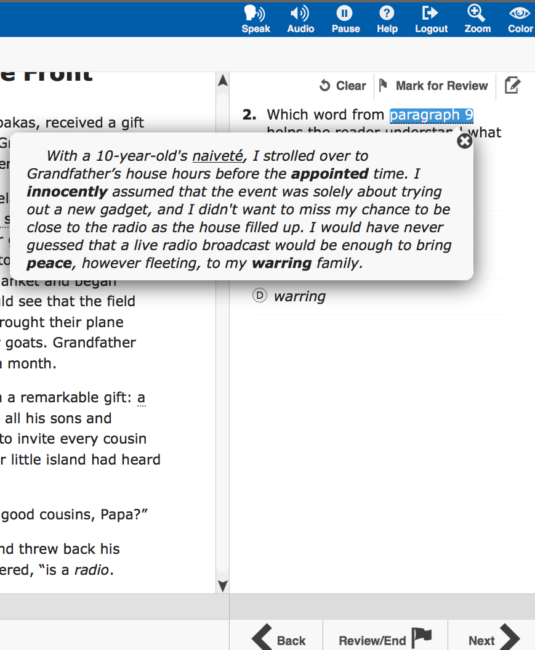
Content & Language Supports
This pop-up also isolates information that corresponds to each answer choice.

Slide 45
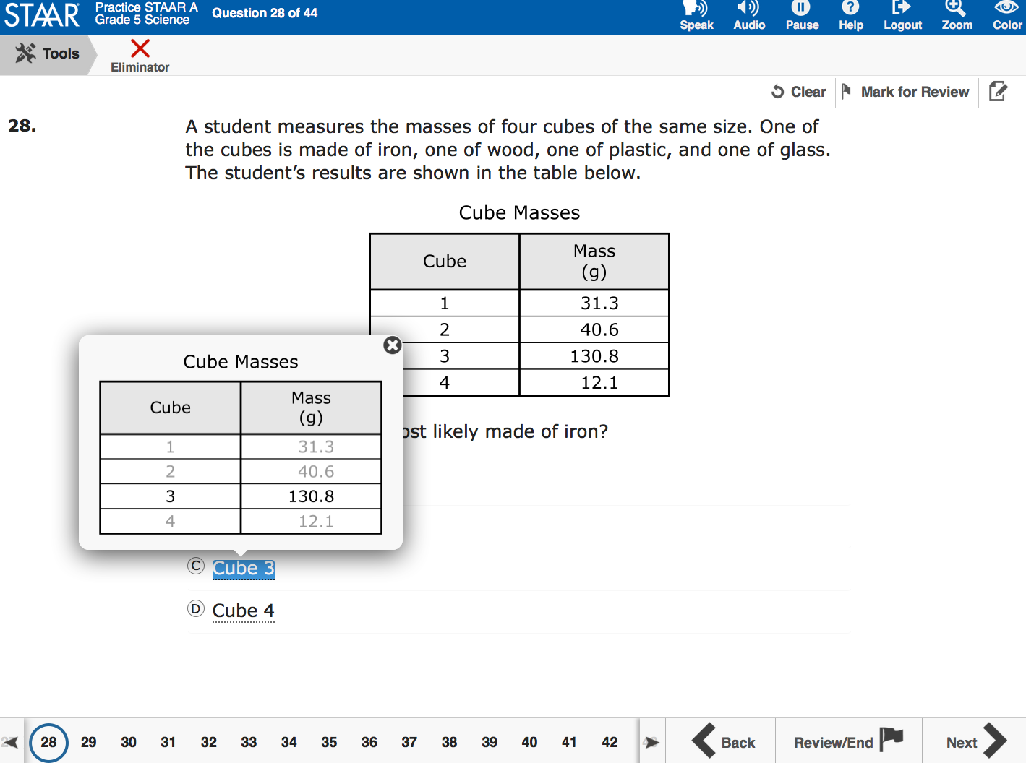
Content & Language Supports
This is another example of a pop-up that isolates information that corresponds to each answer choice.

Slide 46
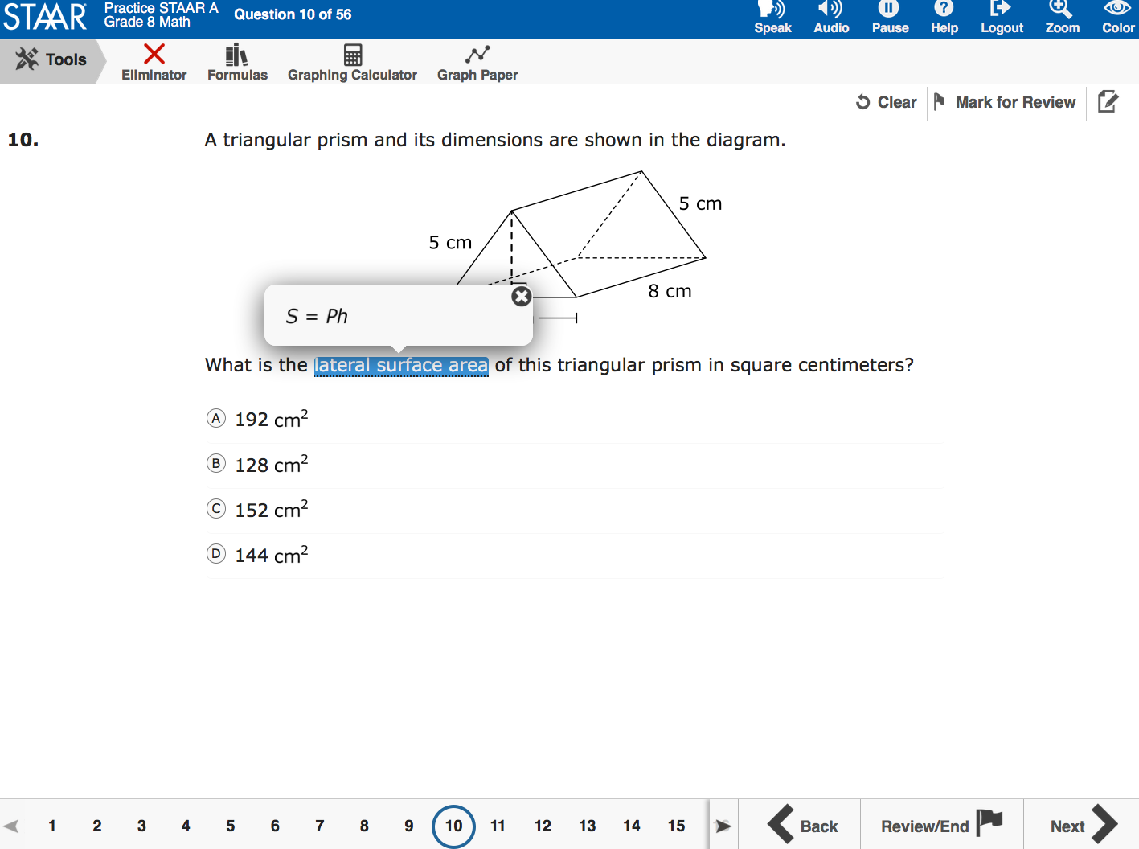
Content & Language Supports
This pop-up provides a formula from the reference material.

Slide 47
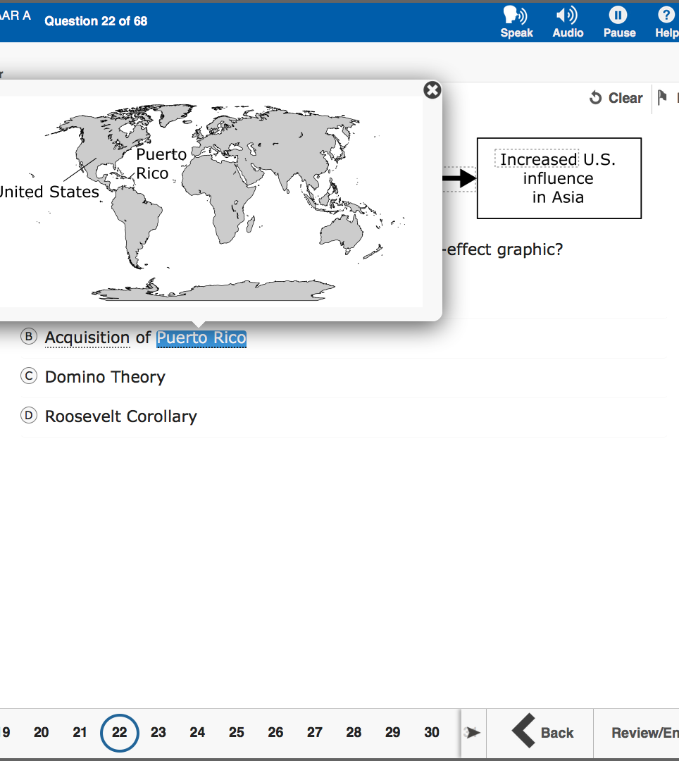
Content & Language Supports
This pop-up provides a supplemental aid
(i.e., map).

Slide 48
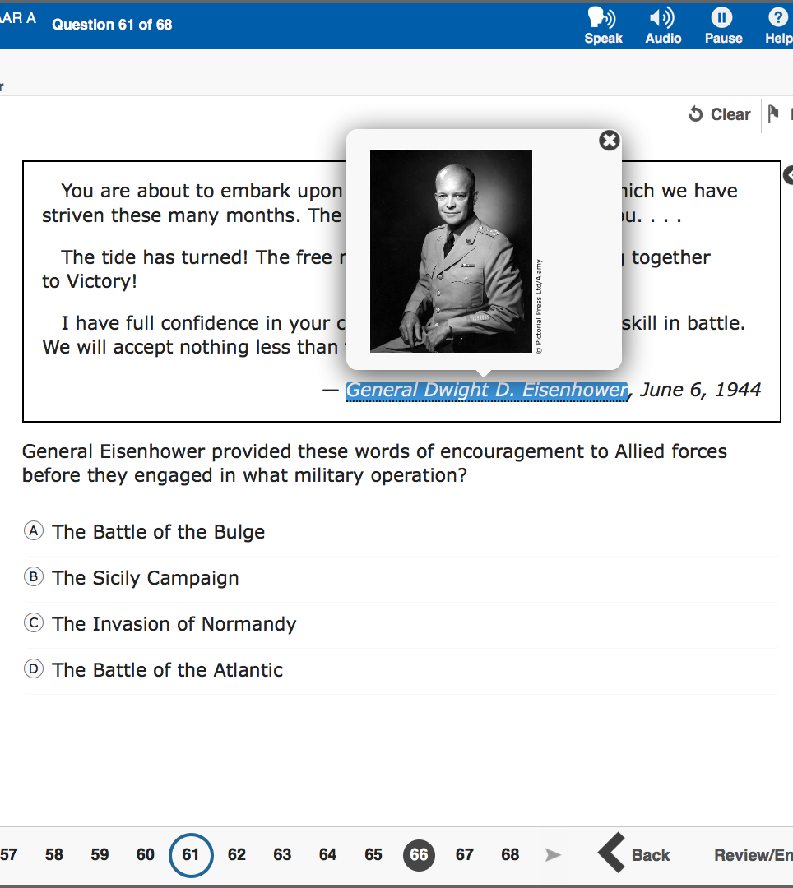
Content & Language Supports
This pop-up provides a visual representation (i.e., photograph) of a historical figure.

Slide 49
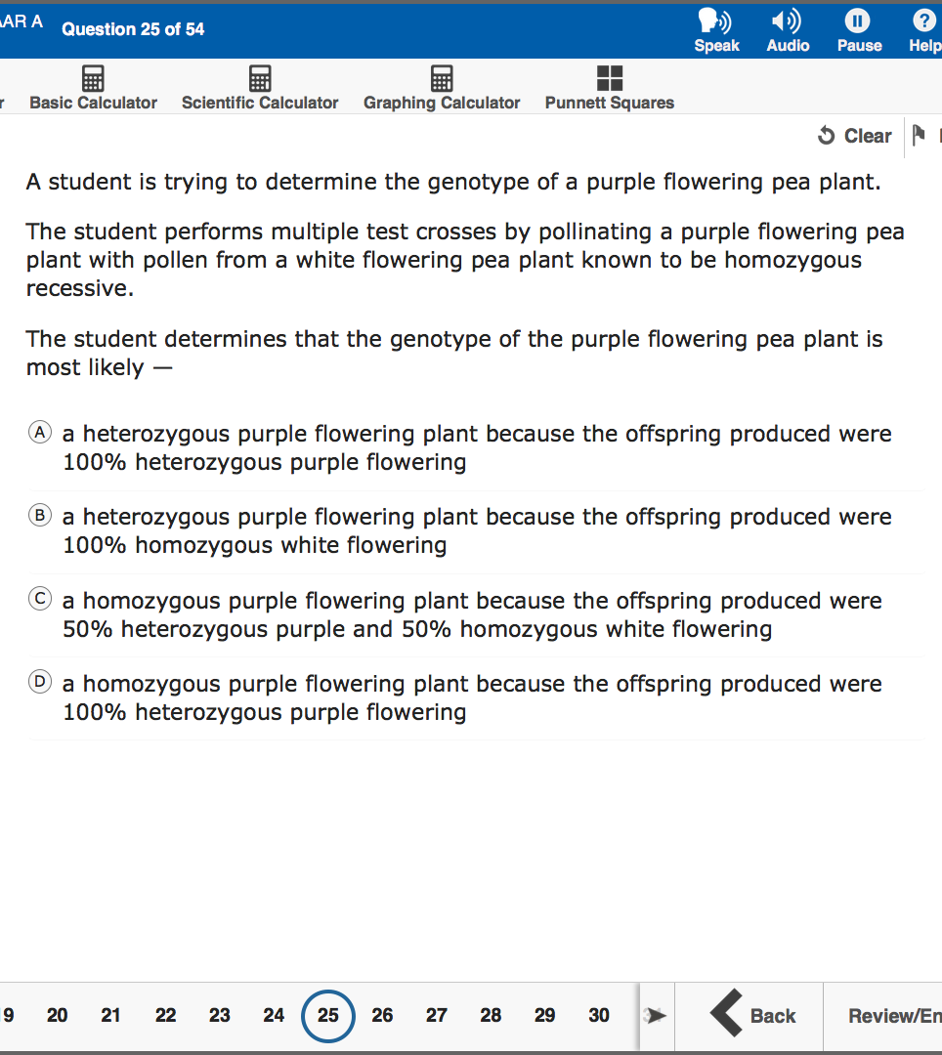
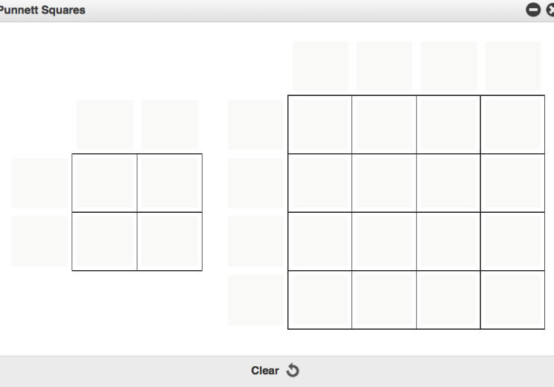
Content & Language Supports
This is a supplementary material. Blank Punnett squares are available for a student to use on STAAR biology with Content Supports.

Slide 50
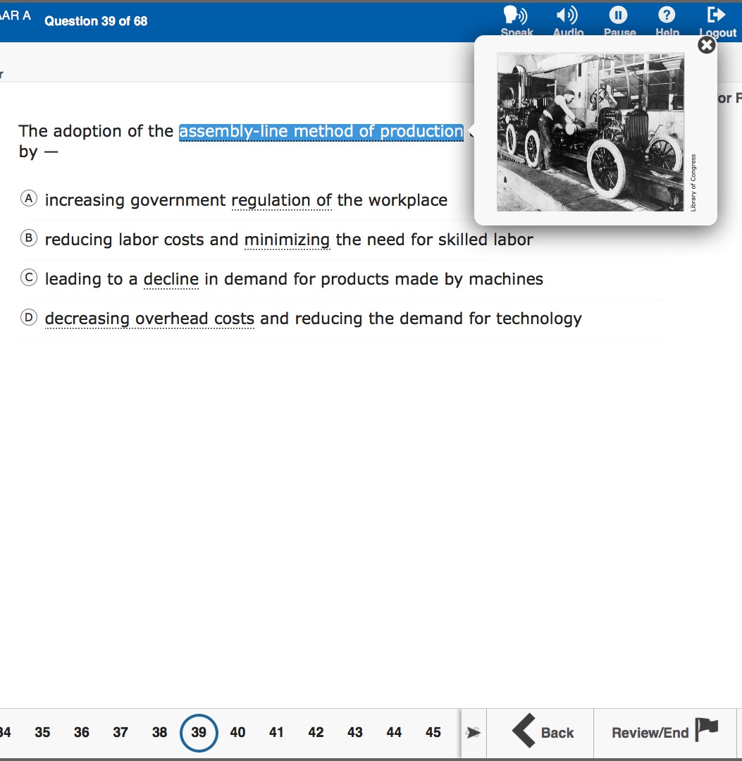
Content & Language Supports
This pop-up provides a visual representation (i.e., photograph) of the vocabulary.

Slide 51
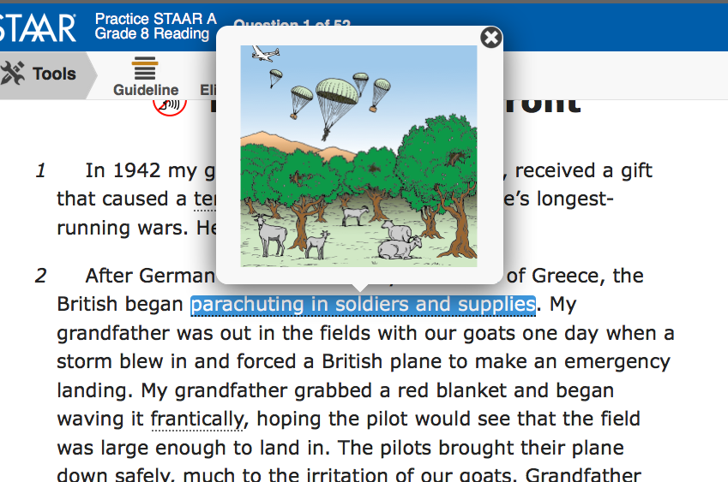
Content & Language Supports
This pop-up also provides a visual representation (i.e., art) of the language in a reading selection.

Slide 52
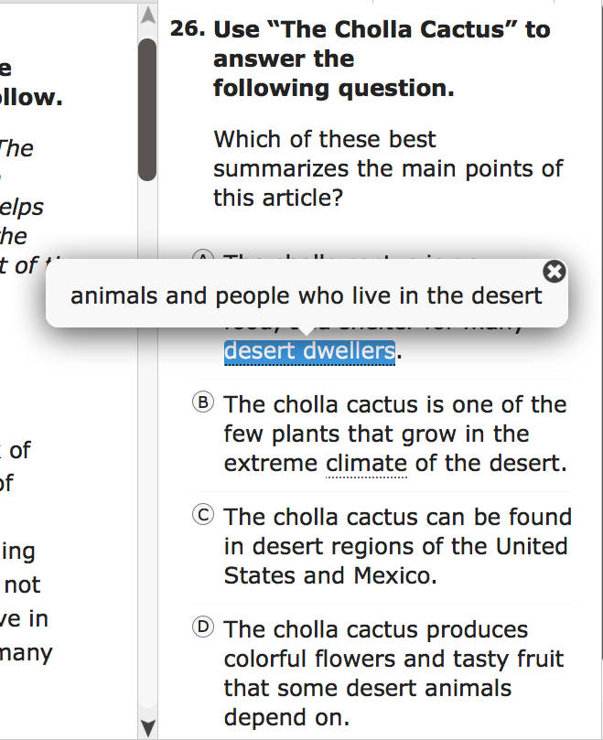
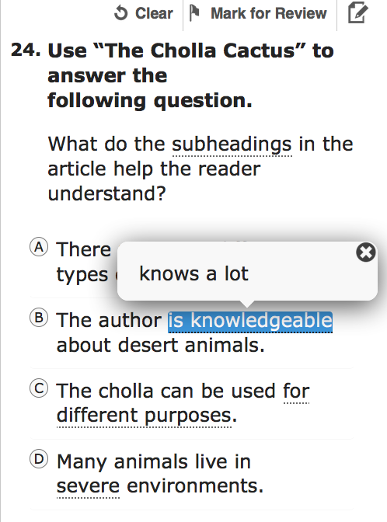
Content & Language Supports
These pop-ups clarify construct-irrelevant words.

Slide 53
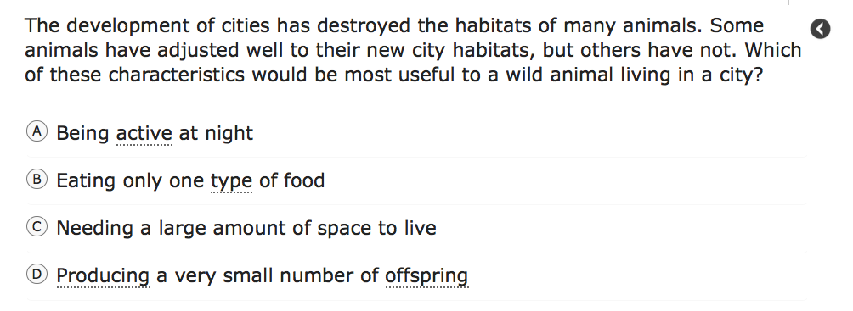
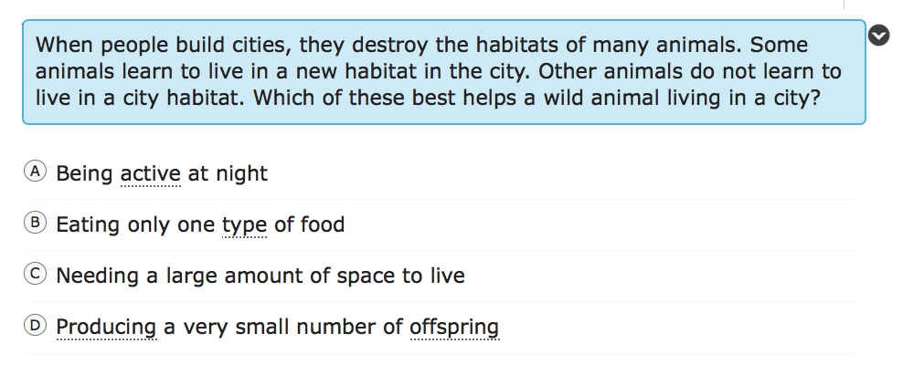
Content & Language Supports
This rollover clarifies text using simpler and consistent language.

Slide 54
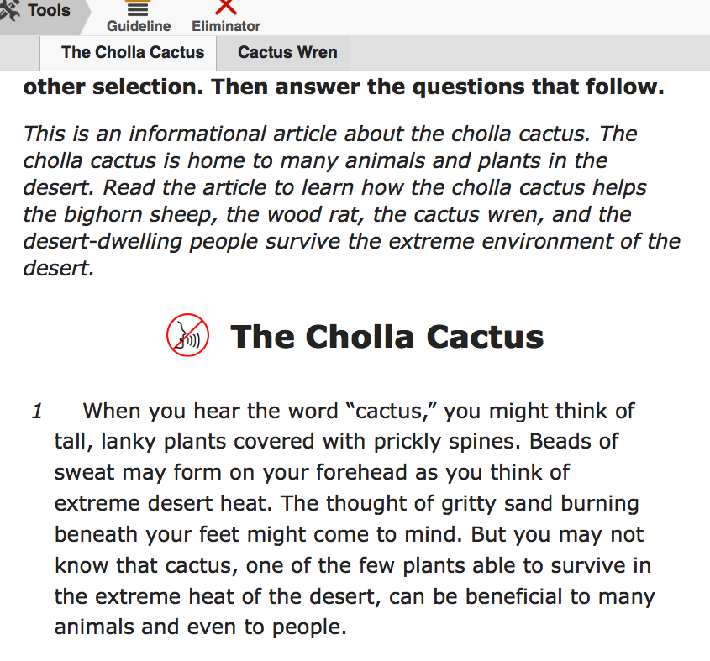
Content & Language Supports
Pre-reading text appears before all reading and writing selections.

Slide 55
Content & Language Supports:
Special Situations
Because Content and Language Supports are embedded accommodations presented in an online format, replicating these features in a paper version is not always possible.
Technology-based supports enable most students to test online; however, a special administration request can be made to TEA for approval to administer a paper test IF…
  the use of an accommodation is not feasible or appropriate for an online administration, or
  the administration of an online test is inappropriate due to a student’s particular disability.
Instructions for submitting a special administration request form will be posted on the TEA’s District and Campus Coordinator Manual 2018 Resources webpage located at https://tea.texas.gov/student.assessment/manuals/dccm/ in early January. We will begin accepting requests in early 2018.
An Accommodation Request Form should NOT be used for these requests. The Designated Response requiring TEA approval will be indicated on the paper request form.
DRAFT

Slide 56
Oral Administration

Slide 57
Oral Administration
Paper
Online
Text to Speech, including embedded supports
Do not document levels
Test administrator
Document levels

Slide 58
Oral Administration
Oral Admin
Content & Language Supports
STAAR Online

Slide 59
Designated Supports for Reading & Writing
Impact on exit criteria

Slide 60
Designated Supports Recommendations for Reading and Writing:
Impact on Exit Criteria for ELLs
Students for whom the LPAC recommends any of the following designated supports for any reading or writing assessment (including English I and English II), may not be considered for exit at the end of the school year.
  Oral Administration
  Content and Language Supports
  Extra Time
  For assessments with multiple administrations (e.g., EOC or SSI grades), STAAR designated supports decisions can be carried over from spring to the June administration ONLY.
  However, the LPAC should meet to document any changes in a student's situation that have occurred between administrations, especially if a student no longer requires designated supports. Remember, some supports may prevent the student from being considered for exit at the end of the year.
New
DRAFT
Notes:
For December 2018 administration, LPACs will have to meet in the Fall to make assessment decisions. 2018 Spring decisions will carry only until June 2018.

Slide 61
What about dictionaries?

Slide 62
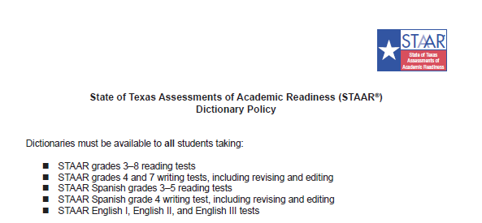
Dictionaries for Reading and Writing in grades 3-5 now included in the STAAR Dictionary Policy and no longer a Designated Support
New
  LPACs should be very familiar with the updated STAAR dictionary policy for all students, which is available on TEA’s STAAR Reading Resources webpage at http://tea.texas.gov/student.assessment/staar/reading/

Slide 63
Dictionary policy change and its impact on ELL exit criteria
The use of dictionaries on reading and writing assessments does not prevent an ELL student to be considered for exit at the end of the year.
However, it is important for LPACs to consider the degree to which the student relies on a dictionary during language arts instruction or testing when making exit decisions.
DRAFT

Slide 64
Dictionaries

Slide 65
Dictionaries
LPACs should be very familiar with the updated STAAR dictionary policy (Reading/Writing/ELA) for all students, since it now includes 3rd-5th grades: www.tea.texas.gov/WorkArea/linkit.aspx?LinkIdentifier=id&ItemID=51539613203&libID=51539613202
Remember! The use of bilingual dictionaries can be found under the accessibility features (Math, Science and Social Studies). Their use DOES NOT have to be documented by the LPAC: http://tea.texas.gov/student.assessment/accommodations/

Slide 66
Decisions about Special Provision, Exemption, and Multiple Administrations

Slide 67
English I EOC Special Provision TAC §101.1007
For ELLs who ―
  have been enrolled in U.S. schools* 3 school years or less (5 or less if qualifying unschooled asylee/refugee), and
  have not yet attained TELPAS advanced high reading rating in grade 2 or above.
When enrolled in an English I/ESOL I course, an eligible ELL shall not be required to retake the assessment each time it is administered if the student passes the course but does not pass the test.
  Students are not exempt from testing while in the course.
  Provisions do not apply to English II or English III.
  This provision is not tied to any particular graduation plan.
  *US Schools = Public, private, home school in the 50 states, D.C. and U.S. DoD (not PR)
DRAFT
Notes:
Why this provision? In English I/ESOL I, these students may require substantial instructional scaffolding and accommodations, or designated supports not feasible on standardized language arts assessments.
Students needs to re-establish eligibility when they pass the course.

Slide 68
Exemption for Qualifying Asylees and Refugees
Amendment to 19 TAC §101.1005 allows for the exemption of certain qualifying ELL asylees and refugees from being administered a STAAR assessment in grades 3–8 only.
This exemption only applies to those unschooled asylees and refugees in their first year in U.S. schools.
DRAFT

Slide 69
ELLs with Parental Denials

Slide 70
ELLs with Parental Denials
LPACs may not recommend designated supports, special assessment considerations, or accountability provisions for an ELL whose parents have denied bilingual or ESL services.
This includes:
No designated supports
No testing in Spanish
No English I special provision
No unschooled asylee/refugee provisions
DRAFT

Slide 71
Documentation of STAAR Test Decisions

Slide 72
Suggested Forms for LPAC Use
STAAR Participation and Accommodation, or Designated Support, Decisions
Eligibility for STAAR English I Assessment Special Provision
Student History Worksheet
Forms may be modified and reformatted for local use (Microsoft Word format).
School districts may require additional supporting documentation and evidence.
These documents will be posted at: http://tea.texas.gov/student.assessment/ell/lpac/
DRAFT

Slide 73
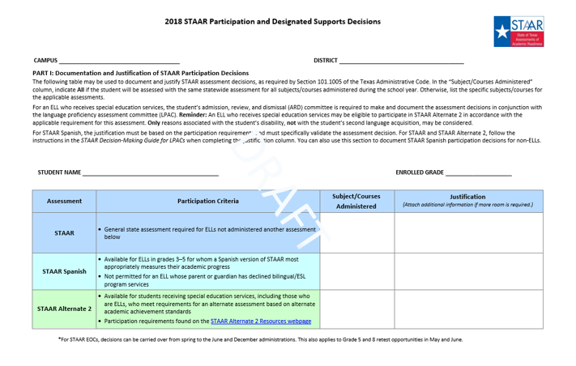
STAAR Participation and
Accommodation Decisions
Updated
DRAFT

Slide 74
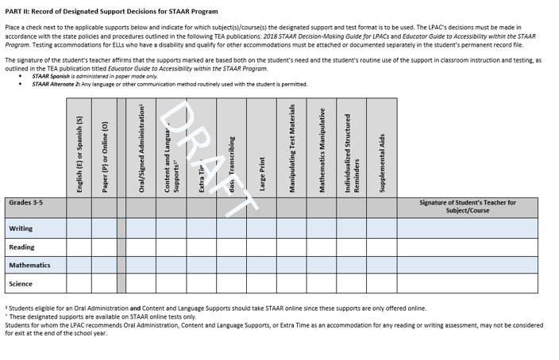
DRAFT

Slide 75
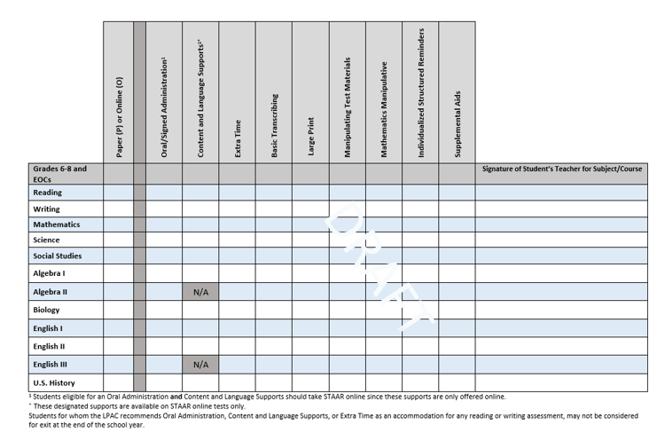
DRAFT

Slide 76
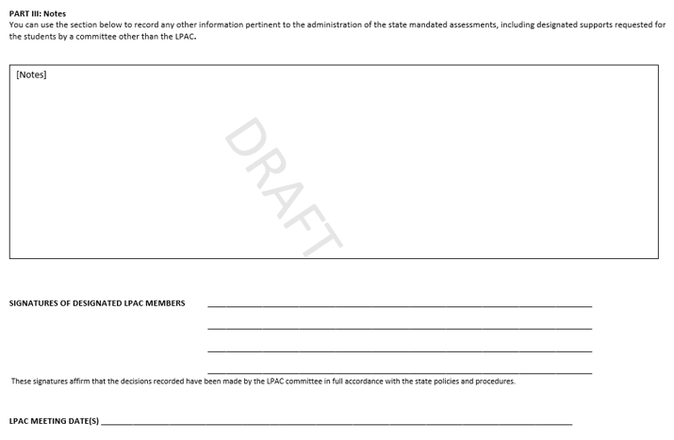
All required members
DRAFT

Slide 77
Eligibility for STAAR English I Assessment Special Provision
The form includes TAC special provision and eligibility criteria.
Course participation (semester or school year) and assessment date must be documented for each ELL that meets eligibility criteria.
Documentation must be completed and discussed with student as close to the time of the assessment as possible.
Special provision only applies when student meets eligibility criteria and passes the course.
The student may opt to retake the assessment during any scheduled administration if the student passes the course but fails to meet the passing standard.
DRAFT
Notes:
The student may opt to retake the assessment during any scheduled administration if the student passes the course but fails to meet the passing standard.

Slide 78
Student History Worksheet
Multiple-year student record of —
  number of school years of enrollment in U.S.
  TELPAS reading rating
  test decisions
  whether student has been enrolled for 60 consecutive school days in a school year
Includes signature and date area for each year’s updated Years in U.S. Schools information to help ensure annual accuracy of this important data collection
DRAFT

Slide 79
TELPAS

Slide 80
Changes to 2018 Accessibility Features that include TELPAS
Additional assistive tools
  amplification devices (e.g., speakers, frequency-modulated [FM] systems)
  projection devices (e.g., closed-circuit televisions [CCTVs] or LCD projectors for online tests)
Photocopying or enlarging the following non-secure test materials (applies to approved paper only):
  test administration directions
  blank answer documents
Note: These accessibility features were previously designated supports.
DRAFT

Slide 81
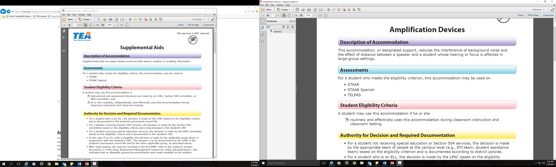

Designated Supports
Designated supports for TELPAS include:
  Basic Transcribing
  Individualized Structured Reminders
  Large Print (approved paper only)
  Manipulating Test Materials
  Spelling Assistance (new)
  Complex Transcribing (new) *
  Extra Day
  Other
Accommodation Request Form is required for TEA approval.
*For TELPAS grades 2-12 writing, complex transcribing does not require an Accommodation Request Form. Refer to the Special Instructions/Considerations section for additional information.
DRAFT

Slide 82
Spelling Assistance:
Student Eligibility Criteria
New
A student is eligible if the student…
receives 504 or special education services,
routinely, independently, and effectively uses it during classroom instruction and classroom testing, and
is capable of organizing and developing ideas and understands the basic function and use of written language conventions (e.g., sentence structures, irregular verbs) but has a disability that is so severe that he or she cannot apply basic spelling rules or word patterns (e.g., silent letters, base words with affixes) to written responses.
Important: This information is only one component of Spelling Assistance. Districts must read, review, and adhere to the Spelling Assistance policy. Document is located on the Accommodation Resources webpage.
DRAFT

Slide 83
Spelling Assistance:
Examples/Types
The designated support may include only
visual sound cards
frequently misspelled word list (e.g., student-made, teacher-made, commercially produced)
Spell check function on a word processor
pocket spell-checker
word-prediction software
text-to-speech software or devices
speech-to-text software, applications, or devices
Important: This information is only one component of Spelling Assistance. Districts must read, review, and adhere to the Spelling Assistance policy. Document is located on the Accommodation Resources webpage.
DRAFT

Slide 84
Complex Transcribing:
Student Eligibility Criteria
New
A student is eligible if the student…
routinely and effectively uses this designated support during classroom instruction and classroom testing,
is unable to effectively use Basic Transcribing to address this need, and
meets at least one of the following.
  The student has an impairment in vision (e.g., uncorrected vision, nystagmus, qualifies for special education services with a Visual Impairment [VI]) that necessitates the use of braille or large-print test materials.
  The student has a physically disabling condition (e.g., muscular dystrophy, cerebral palsy, arthritis) that prevents him or her from independently and effectively recording responses on the lined pages of the answer document or in the space provided in the Texas Assessment Management System for online tests.
Important: This information is only one component of Complex Transcribing. Districts must read, review, and adhere to the Complex Transcribing policy. Document is located on the Accommodation Resources webpage.
DRAFT

Slide 85
Special Administration of TELPAS
In rare circumstances that prevent a student from testing online, TEA may grant approval for a special administration of a TELPAS online test (reading/listening and speaking) for grades 2–12.
  Accommodations cannot be applied - A student may need a testing accommodation that is not possible to provide in an online setting. Prior to requesting a special administration of the assessment, consideration should be given to accessibility features, locally-approved designated supports, and designated supports requiring TEA approval. For information regarding these testing accommodations, refer to the Accommodation Resources page.
  Technology access is precluded - Districts must make every effort to administer STAAR with Embedded Supports, TELPAS reading, and TELPAS listening and speaking online. In rare situations where computers or technology are absolutely not available, districts may seek permission for a special administration.
Decision recommendation for a special administration of TELPAS must be determined by the appropriate team of people at the campus level (e.g., RTI team, student assistance team, 504 team).
  Note: Special administration of TELPAS is dependent upon TEA approval
DRAFT

Slide 86
TELPAS Resources for LPACs
Years in U.S. Schools Data Collection Document
  Years in U.S. schools collected annually for each ELL during TELPAS
  Used in determining performance requirements in various state and federal accountability measures
  Document contains instructions for determining years in U.S. schools, including 60-day rule information
2018 TELPAS Decision-Making Guide for LPACs
  Includes information on assessing ELLs receiving special education services with TELPAS
2018 Accessibility Features
  Certain accessibility features may also be provided for TELPAS
DRAFT

Slide 87
Calculating Years in U.S. Schools
Districts are not changing the value for years in U.S. schools submitted in a previous school year. Districts are using the data previously submitted to inform data that will be submitted this spring.
The number of years in U.S. schools on record for a student will never decrease. The value will either remain the same or increase by 1.
DRAFT

Slide 88
Data Collection for Spring
In addition to years in U.S. schools, other information that will be collected includes:
Unschooled asylees/refugees
    These students lack literacy skills in their first language and basic subject-matter knowledge and skills. They may also lack basic social skills and have experienced emotional trauma as a result of their previous circumstances.
Students with Interrupted Formal Education (SIFE)
    These ELLs attend school in the U.S., withdraw and leave the U.S. for a period of time, and then return to the U.S. The period of time outside of the U.S. or the number of times the student is withdrawn from U.S. schools is significant enough that growth in English and learning of subject matter are affected.
    These ELLs may come to the U.S. with limited or no prior schooling. They lack literacy skills in their first language, basic subject-matter knowledge and skills, or basic social skills. For the purpose of this data collection, include ELLs who did not attend school for a period of time such that the ability to learn English and new grade level subject-matter knowledge and skills is significantly affected.
DRAFT

Slide 89
Alternate English Language Proficiency (ELP) Assessment
Preview

Slide 90
Federal Requirements Assessment Federal Requirements
34 CFR §200.6(h)(5) requires that a State administers an alternate ELP assessment for English learners (ELs) with the most significant cognitive disabilities who cannot participate in the ELP assessment even with appropriate accommodations.
DRAFT

Slide 91
Alternate ELP Assessment
Texas is creating a holistic inventory to assess English language proficiency to
  satisfy the Alternate ELP assessment requirement for students with the most significant cognitive disabilities (SWMSCD)
  reduce exemptions from specific language domains on the general TELPAS
DRAFT

Slide 92
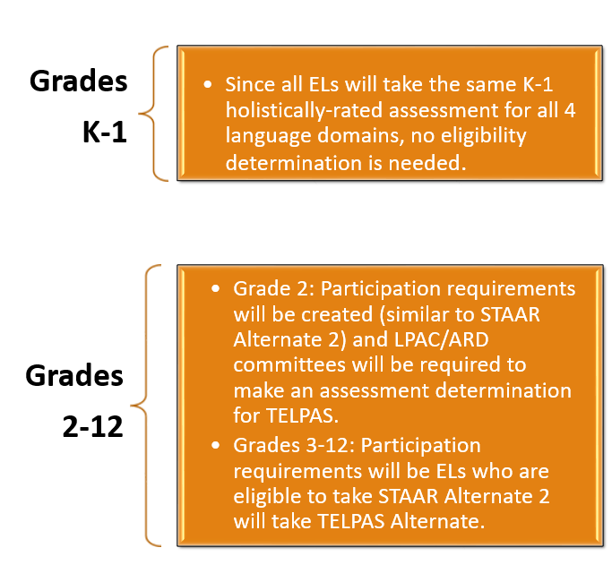
Who will be assessed with the Alternate ELP Assessment?
Spring 2018 Cog Lab
Spring 2019 Administer TELPAS Alt Assessment
DRAFT

Slide 93

Alternate
ELP
Assessment Cog Lab
Late April-Early May
LEAs will receive a letter from TEA soliciting districts to participate in the cognitive lab:
including the proposed calendar for completing cognitive lab activities and
describing the procedures for districts who will volunteer to participate.
Participation is a golden opportunity to inform Texas’ first language proficiency assessment created specifically for ELs with significant cognitive disabilities!
DRAFT

Slide 94
Final LPAC MOY Power Point
The final PowerPoint and all other LPAC guides and documents will be posted on the Language Proficiency Assessment Committee Resources page of the Student Assessment Division website at:
http://tea.texas.gov/student.assessment/ell/lpac/
DRAFT

Slide 95
Contact Information
Information regarding Assessments for ELLs:
http://tea.texas.gov/student.assessment/ell/
TEA Student Assessment Division phone number:
(512) 463-9536
Email: assessment.specialpopulations@tea.texas.gov
New
DRAFT

Slide 96

Region One ESC Contacts
Karina E. Chapa, M.Ed.
Language Proficiency, Biliteracy
and Cultural Diversity Director
kchapa@esc1.net
Twitter @esc1bilingual @bilingualpride
Xochitl A. Rocha, Ed.D.
Bilingual/ESL Specialist
xrocha@esc1.net
Twitter @xochitlrocha5
Center for Excellence in Education of Diverse Learners (CEEDS)

